Slide 1
Overview of the career guidance system in Slovakia
Ladislav Ostroha, Euroguidance Slovakia

Slide 2
Euroguidance network
established in 1992
funded by the European Commission (Programme Erasmus+)
national units in 34 European countries
promoting European dimension of career guidance through:
Developing competences of career practitioners
Encouraging networking and cooperation among guidance providers and relevant stakeholders
Sharing quality information on key national as well as European developments and training opportunities in careeer guidance
website: www.euroguidance.eu

Slide 3
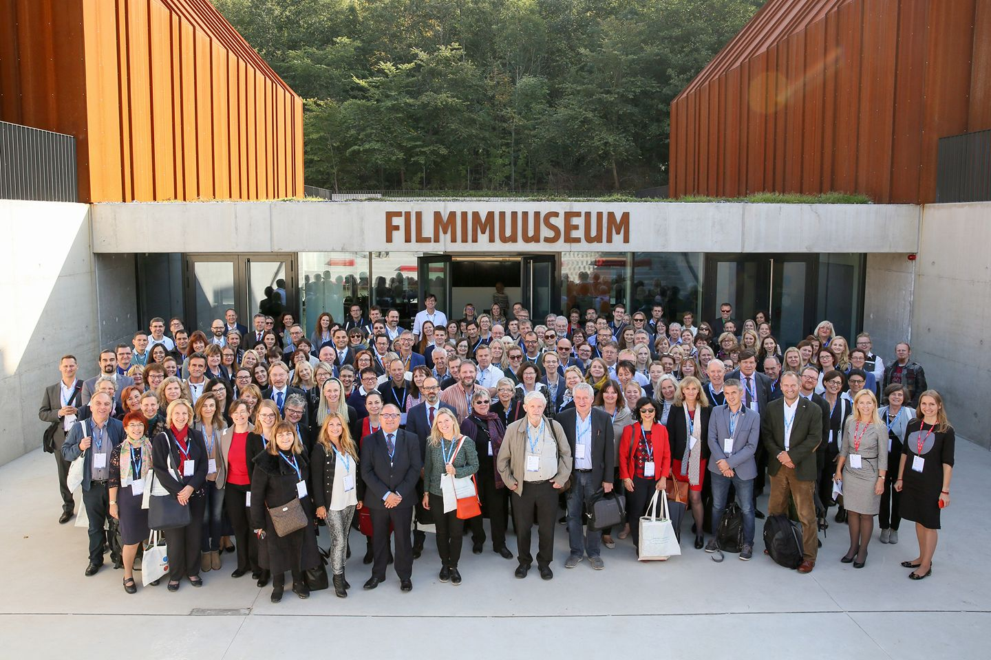

Slide 4
Euroguidance centre Slovakia
operating since 1998
co-funded by the European Commission and the Ministry of Education
located under the same organisation as the National Agency Erasmus+
Main activities:
advocacy and cooperation with wide range of stakeholders and guidance providers
organisation of regular training events (e.g. Summer School of Career Guidance)
encouraging peer learning and exchange of good practices (National Career Guidance Awards)
promoting learning mobility of career practitioners (e.g. Academia Network, Cross-Border Seminars)
cultivating and shaping the discourse about the career guidance in Slovakia (e.g. professional journal)
Vision: accessible and professional career guidance services

Slide 5
Guidance system in Slovakia – features
Strong sectoral approach (education vs employment)
Lack of cross-sectoral coordination (policy) unit
Funding of the career guidance services is predominantly project-based
Limited training opportunities for career practitioners
currently no fully-fledged academic programme in career guidance
Key role of professional commnunity in enhancing quality
Professional association (ZKPRK) established in 2014; currently more than 150 members; development of the quality standards and accreditation scheme
Growing importance of the civic sector in diversification of services

Slide 6
Guidance system in Slovakia - challenges
Professionalisation
career guidance still seen as a function rathen than a vocation
Lack of strategic leadership and coordination
Limited outreach
Sustainability
External factors
COVID-19
digital revolution and automation
climate change...

Slide 7
Guidance system in Slovakia – ways forward
New policy initiatives (Lifelong Guidance Strategy, Curriculum reform)
Quality assurance, Monitoring, Evaluation
Decentralisation and diversification
Peer exchange and learning among guidance providers

Slide 8
https://careerguidancecourse.eu/

Slide 10
Thank you for your attention
Ladislav Ostroha
ladislav.ostroha@saaic.sk
linkedin.com/in/ladislavostroha

